Slide 1
Module 9: Create Paginated Reports in Power BI

Slide 2
Learning Objectives
You will learn the following concepts:
Paginated Reports
What are they?
When they should be used
Charts and Tables
Publishing a paginated report
Notes:
By the end of this module, you’ll be able to:
What paginated reports are and when they should be used.
Create a paginated report.
Use charts and tables.
Publish a paginated report.

Slide 3
Lesson 1: Paginated Report Overview

Slide 4
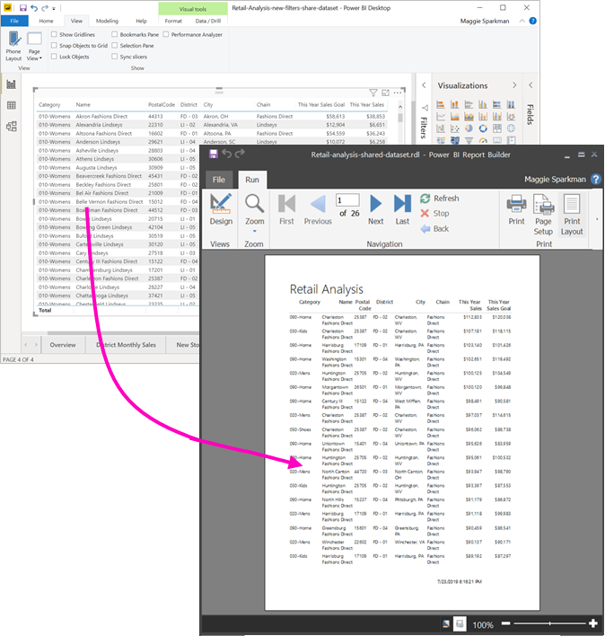
Introduction to Paginated Reports
Descendant of SQL Server Reporting Services.
Created in Power BI Report Builder.
Part of Power BI Premium.
Notes:
Paginated reports allow report developers to create Power BI artifacts that have tightly controlled rendering requirements. Paginated reports are ideal for creating sales invoices, receipts, purchase orders, and tabular data. This module will teach you how to create reports, add parameters, and work with tables and charts in paginated reports.
Power BI paginated reports are descendants of SQL Server Reporting Services (SSRS), which was first introduced in 2004. Power BI paginated reports and SSRS have a lot in common. If you're are looking for information on paginated reports and can't find it, searching the internet and Microsoft documentation on SSRS is an excellent idea because you'll find numerous blog posts, videos, and documentation available to you.
Paginated reports give a pixel-perfect view of the data. Pixel perfect means that you have total control of how the report renders. If you want a footer on every sales receipt that you create, a paginated report is the appropriate solution. If you want a certain customer's name to always appear in green font on a report, you can do that in a paginated report.

Slide 5
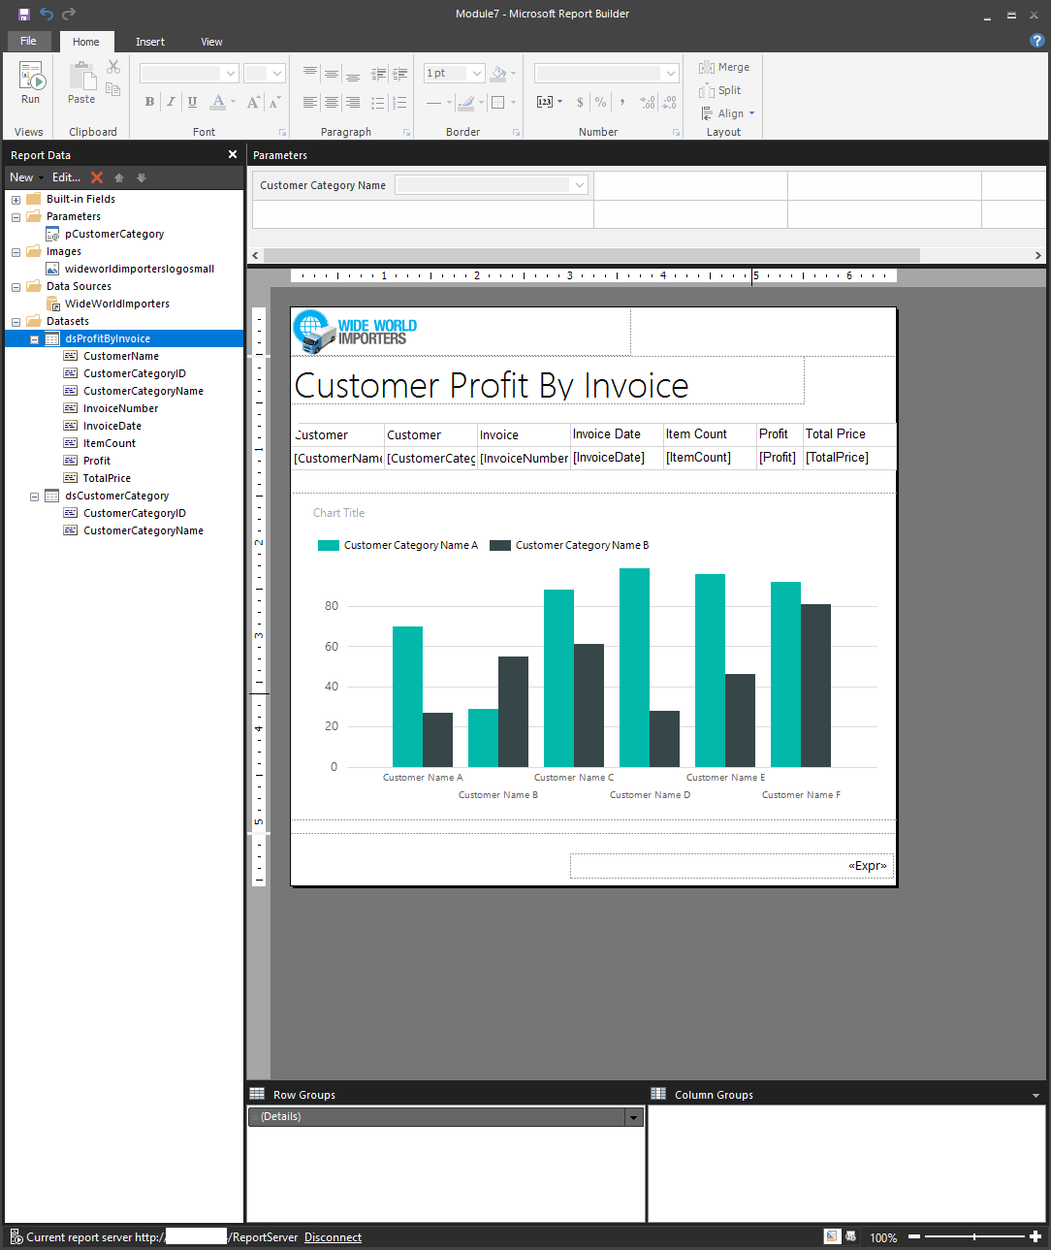
When are they the right fit?
Operational reports with tables of detail.
Headers and footers are needed.
Customized sort orders.
Clickable headers.
Rendering tabular data.
Notes:
You can use paginated reports for operational reports with tables of details and optional headers and footers.
Additionally, you can use paginated reports when you expect to print the report on paper or when you want an e-receipt, a purchase order, or an invoice. Paginated reports also render tabular data exceedingly well. You can have customized sort orders, clickable-headers, and URLs in results, which allows for simple integration with custom applications.
Power BI paginated reports can also display all of your data in a single report element, such as a table. If you have 25,000 records, and you want the reports to print over 100 pages, you can do that. If you want every third record to be printed with a light pink background, you can do that as well.
Power BI paginated reports are not created in Power BI Desktop; they are built by using Power BI Report Builder. Power BI paginated reports are a feature of Power BI Premium.

Slide 6
Lesson 2: Creating Paginated Reports

Slide 7
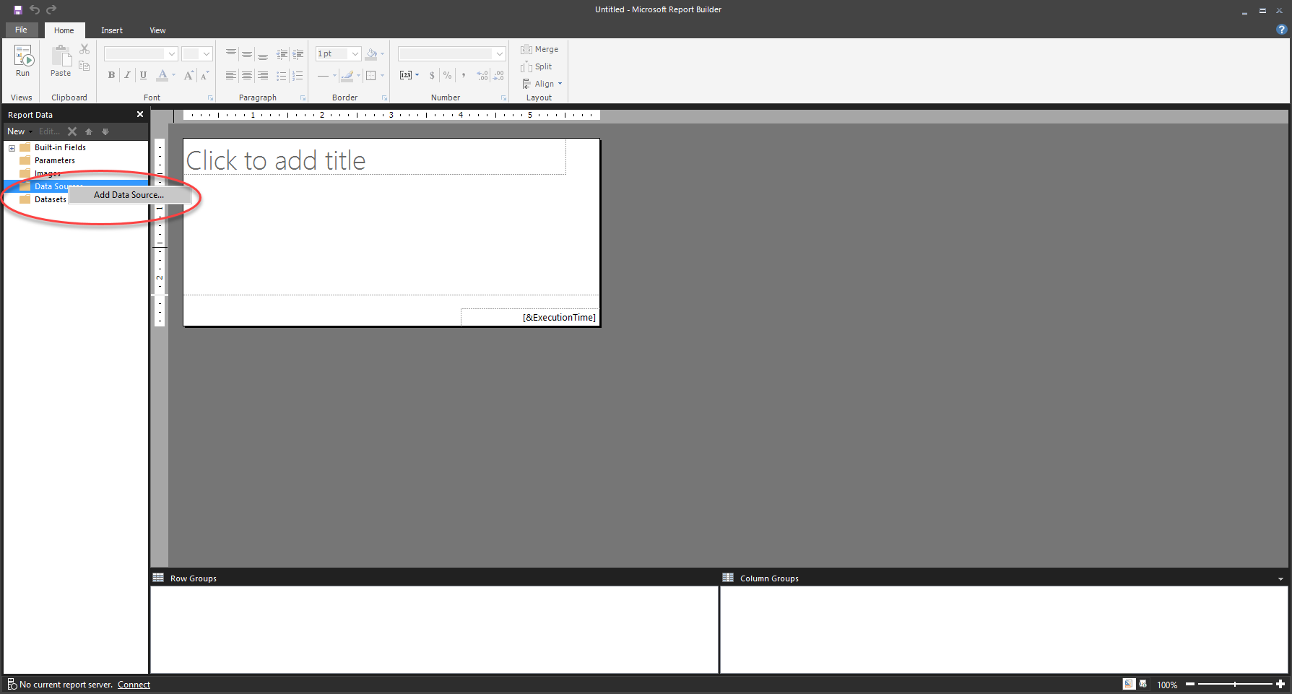
Getting Data
Notes:
The first step in creating a report is to get data from a data source. Though this process might seem similar to getting data in Power BI, it is different. Power BI paginated reports do not use Power Query when connecting to data sources.
Getting data in a Power BI paginated report does not involve data cleaning steps. In fact, data is not stored in a Power BI paginated report dataset. When data is refreshed on the report, it is retrieved in an unaltered form from the data source, according to the query that was used to retrieve it.
Data can be collected from multiple data sources, including Microsoft Excel, Oracle, SQL Server, and many more. However, after the data has been collected, the different data sources cannot be merged into a single data model. Each source must be used for a different purpose.
A data source is the connection information to a particular resource, like SQL Server. A dataset is the saved information of the query against the data source, not the data. The data always resides in its original location.
To create a data source:
Add a data source: Right-click the Data Sources folder and select Add Data Source. Provide a name for the data source.
Connection: After naming the data source, choose the correct connection string by selecting the Build button. After you have selected Build, the Connection Properties screen appears. The properties on this screen will be unique for each data source.
Dataset: Right-click Datasets in the Report View window and select Add Dataset. Ensure that the correct data source is selected. This action will run the query against the correct data source.
Name the query, select the query type (text, table, or stored procedure), enter a query if needed.

Slide 8
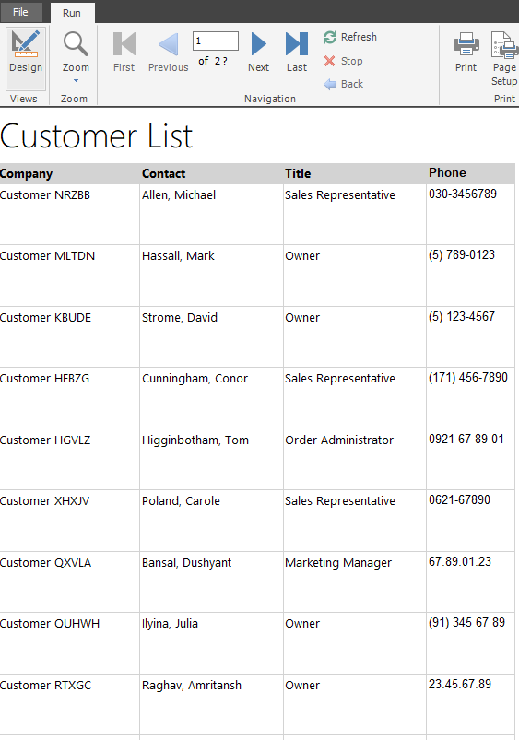
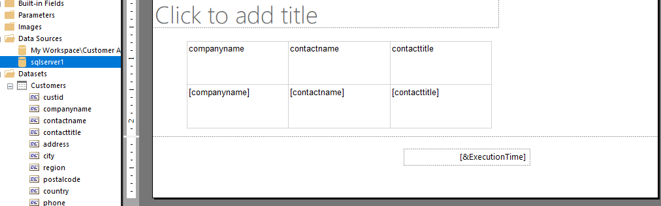
Create a Paginated Report
Similar to Power BI, add visuals to the design surface.
Notes:
To create a report, you must add a visual to the design surface, similar to what you would do in Power BI Desktop. Select the Insert tab from the ribbon at the top to see your options for adding a visual.
For the purposes of this example, a table visual has been added to the design surface.
When you select the Table drop-down menu, you can choose from two options: Insert Table or Table Wizard. Select Insert Table.
You can now draw a table on the design surface. From the Report data window, drag fields from the dataset to the table on the design surface.
When you have finished, notice that the field is added to the lower portion of the table in the square brackets. The header will also be added. You can rename or apply formatting to the headers, such as bolding or underlining the text.
To test this simple report, select the Run button from the Home tab in the ribbon.
Notice that some items have changed in the report: a title was entered at the top, table headers were renamed and are in bold font, and a background color was selected on the header. These changes were implemented to help make using the report easier for the report reader.
If you want to return to the design surface, select the Design button.
Add parameters
Another aspect of creating a report is to add a parameter. Parameters can be used for different reasons, for example, when you want the user to enter information that displays on a visual on the report. The most popular reason to add a parameter is to affect which data is retrieved from the data source.

Slide 9
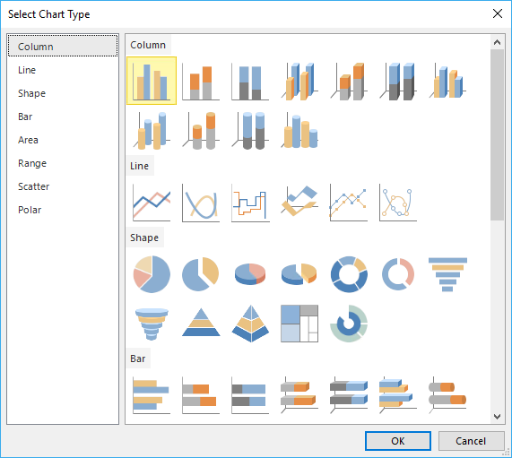
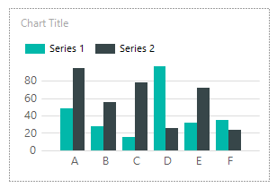
Work with Charts and Tables
Notes:
The more time you spend carefully preparing and understanding your data before you create a chart, the easier it will be to design your charts quickly and efficiently.
Two ways to add a chart to your report are: Select the Chart button, select Insert Chart, and then draw your table on the canvas.
Right-click the report canvas, select Insert, and then select Chart.
Next, choose the type and style of your chart.
After you have selected a chart type, the chart will be added to the design surface.
When you select the chart, a new window appears to the right. The Chart Data screen allows you to format the chart according to the values and axis properties.

Slide 10
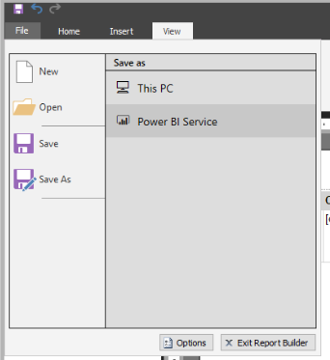
Publish the Report
Publish your report to the Power BI service.
Notes:
To publish your report, select File > Save as and then select Power BI Service. Your report will now appear in Power BI service.
You can upload paginated reports to your My Workspace or any other workspace, as long as the workspace is in a Premium capacity.
If your report data source is on premises, you need to create a gateway after you upload the report.
Creating a report is meant to inform and drive action on the part of the report user. It isn't enough to create a report with sales information on it; the report author should always ask themselves several questions:
What purpose is this report for?
Who is using the report?
How can I help people do a better job?
What is the most important information and how can I highlight it?
Is this report readable?
Can people change the elements that they need to if their questions change?
Do I have visuals that are distracting from the core message of the report?
Is this report staying focused in a single topic or only a few topics?
Am I providing all information that the user expects to see in the report?
A good report author creates reports that are easy on the data source. If you continue to recall data that you don't need from a data source, you will overburden the data source and affect performance in unpredictable ways. Focusing on only getting pertinent data will help you be a responsible teammate to others who are using the same data.

Slide 11
Lab: Creating a Paginated Report

Slide 12
Module Overview
We covered the following concepts:
Paginated Reports
What are they?
When they should be used
Charts and Tables
Publishing a paginated report
Notes:
In this module we discussed:
What paginated reports are and when they should be used.
How to create a paginated report.
How to use charts and tables.
How to publish a paginated report.

